Slide 1
The New Title IX: the way forward FOR INVESTIGATORS

Slide 2
Richard Rasmussen Copyright © 2020 Diligence, LLC

Slide 3
Part 106 Changes
Nondiscrimination on the basis of sex in education
Cite as 34 C.F.R. 106
Sexual harassment, including sexual assault, is unlawful sex discrimination, effective 09.14.20..
34 C.F.R. §106.45 requires everyone is trained on new regulations and procedures.
Notes:
PART 106 - NONDISCRIMINATION ON THE BASIS OF SEX IN EDUCATION
Cite as 34 C.F.R. 106
For the first time, the Title IX regulations recognize that sexual harassment, including sexual assault, is unlawful sex discrimination.
Regs effective August 14, 2020
34 C.F.R. §106.45 requires everyone in the Title IX process be trained in these new regulations and procedures!

Slide 4
Why we’re here:
Because 34 C.F.R. §106.45 requires everyone in the Title IX process be trained in these new regulations and procedures!

Slide 5
For the first time, the Title IX regulations recognize that sexual harassment, including sexual assault, is unlawful sex discrimination.

Slide 6
34 C.F.R. §106.6
Compliance with new regs is not obviated or alleviated by the FERPA statute, 20 U.S.C. 1232g, or FERPA regulations, 34 CFR part 99.
For instance: A parent or guardian may act on behalf of a “Complainant,” “Respondent,” “Party,” or other person covered by the new regs, including but not limited to filing a formal complaint.

Slide 7
34 C.F.R. §106.8
Any person may report sex discrimination/harassment (whether or not the person reporting is the victim), in person, by mail, by telephone, or by e-mail, using the Title IX Coordinator’s contact info - or by any other means that results in the Title IX Coordinator receiving the person’s verbal or written report.

Slide 8
NEW DEFINITIONS
Take note

Slide 9
Actual knowledge
34 C.F.R. §106.30
Means notice of sexual harassment or allegations of sexual harassment to your Title IX Coordinator or any official of you who has authority to institute corrective measures on behalf of you.

Slide 10
Complainant
34 C.F.R. §106.30
Means a person who is alleged to be the victim of conduct that could constitute sexual harassment.

Slide 11
Formal complaint
34 C.F.R. §106.30
Means a document filed by a Complainant or signed by the Title IX Coordinator alleging sexual harassment against a Respondent and requesting that you investigate the allegation of sexual harassment.

Slide 12
Sexual harassment
34 C.F.R. §106.30
Means conduct on the basis of sex that satisfies one or more of the following:
A you employee who conditions the provision of an aid, benefit, or service of on an individual’s participation in unwelcome sexual conduct;
Unwelcome conduct determined by a reasonable person to be so severe, pervasive, and objectively offensive that it effectively denies a person equal access to you’s education program or activity; or

Slide 13
(3) “Sexual assault” as defined in 20 U.S.C. 1092(f)(6)(A)(v), “dating violence” as defined in 34 U.S.C. 12291(a)(10), “domestic violence” as defined in 34 U.S.C. 12291(a)(8), or “stalking” as defined in 34 U.S.C. 12291(a)(30).

Slide 14
Respondent
Means an individual who has been reported to be the perpetrator of conduct that could constitute sexual harassment
34 C.F.R. §106.30

Slide 15
Your Response to Sexual Harassment

Slide 16
34 CFR §106.44
When you have actual knowledge of sexual-harassment, you must respond promptly in a manner that is not deliberately indifferent. You must treat complainants and respondents equitably by offering supportive measures to both. Must follow grievance process of compliance with section 106.45 before the imposition of any disciplinary sanctions.

Slide 17
34 CFR §106.45
When you have actual knowledge of sexual-harassment, you must respond promptly in a manner that is not deliberately indifferent. you must provide the full range of support and measures available to all Complainants and Respondents.

Slide 18
34 C.F.R. §106.44
If Complainant files a Formal Complaint, you must follow a grievance process that complies with §106.45.

Slide 19
UNDERSTAND
All of the following requirements are grafted onto your existing substantive and procedural rules and regulations.
Every school may have a different process, but every process must comply with the following requirements.

Slide 20
Responding to Formal Complaints of Sexual Harassment 34 C.F.R. §106.45
Be aware: Your treatment of a Complainant or a Respondent in response to a formal complaint of sexual harassment may constitute discrimination on the basis of sex under Title IX.

Slide 21
Grievance Process
Must be concluded in a “Reasonably Prompt Time Frame.” (No more “60 days!”)
Good cause for delays may include considerations such as the absence of a party, a party’s advisor, or a witness; concurrent law enforcement activity; or the need for language assistance or accommodation of disabilities.
34 C.F.R. §106.45

Slide 22
34 C.F.R. §106.45
Requires an objective evaluation of all relevant evidence – including both inculpatory and exculpatory evidence – and provide that credibility determinations may not be based on a person’s status as a Complainant, Respondent, or witness.

Slide 23
34 C.F.R. §106.45
Requires that the Title IX Coordinator, investigator, Decision-Maker, or any person designated by you to facilitate an informal resolution process, not have a conflict of interest or bias for or against Complainants or Respondents or current parties.

Slide 24
34 C.F.R. §106.45
Requires that ALL persons involved in the Title IX process affirmatively avoid prejudgment of the facts at issue, conflicts of interest, and bias.

Slide 25
34 C.F.R. §106.45
Investigators must not rely on sex stereotypes and must promote impartial investigations and adjudications of formal complaints of sexual harassment.
All parties in the process must presume that the Respondent is NOT responsible for the alleged conduct until a determination regarding responsibility is made at the conclusion of the grievance process.

Slide 26
34 C.F.R. §106.45
Investigators must understand issues of relevance to create an investigative report that fairly summarizes relevant evidence.

Slide 27
34 C.F.R. §106.45
Investigators must be trained to seek and develop both inculpatory and exculpatory evidence.

Slide 28
Once you receive a formal complaint

Slide 29
you must provide written notice to the parties which contains:
Description of your grievance process including any informal resolution process;
The allegations of behavior that potentially constitutes sexual harassment;
Sufficient details known at the time;
Sufficient time to prepare a response before any initial interview;
A statement that the Respondent is presumed not responsible for the alleged conduct and that a determination regarding responsibility is made only at the conclusion of the grievance process.

Slide 30
Written Notice Also Contains 34 C.F.R. §106.45
Notice the parties may have an advisor of their choice.
Right to inspect and review evidence.
Any provision in your code of conduct that prohibits lying during the grievance process.

Slide 31
34 C.F.R. §106.45
If the investigation reveals that the conduct alleged in the formal complaint would not constitute sexual harassment OR did not occur in your education program or activity OR did not occur against a person in the United States, then you must dismiss the formal complaint.

Slide 32
Also may dismiss the formal complaint if
The Complainant notifies the Title IX Coordinator in writing that the Complainant would like to withdraw the formal complaint or,
If the Respondent is no longer enrolled in or employed by you.

Slide 33
What about new allegations not listed in the original notice?
You must provide notice of the additional allegations to the parties whose identities are known.

Slide 34
The Investigator

Slide 35
The Investigator Must
34 C.F.R. §106.45
Ensure that the burden of proof and the burden of gathering evidence rests on you and not on the parties!
You cannot access, consider, disclose, or otherwise use a party’s records that are made or maintained by a physician, psychiatrist, psychologist, or other recognized professional.
Unless you obtains that party’s voluntary, written consent to do so for the grievance process.
Notes:
PART 106 - NONDISCRIMINATION ON THE BASIS OF SEX IN EDUCATION
Cite as 34 C.F.R. 106
For the first time, the Title IX regulations recognize that sexual harassment, including sexual assault, is unlawful sex discrimination.
Regs effective August 14, 2020
34 C.F.R. §106.45 requires everyone in the Title IX process be trained in these new regulations and procedures!

Slide 36
The Investigator Must 34 C.F.R. §106.45
Give parties equal opportunity to present witnesses, including fact and expert witnesses, and other inculpatory and exculpatory evidence.

Slide 37
Preliminary steps
Discuss and create an investigatory plan with the Title IX Coordinator.
Develop the investigative timeline.
Collect and organize initial information, statements and documentary and physical evidence.
You should not wait for the conclusion of a criminal investigation or criminal proceedings to begin their own Title IX investigation. Care is warranted. Communication and coordination with law enforcement are a “MUST.”

Slide 38
Set Timelines & Benchmarks For:
Interviewing parties
Interviewing witnesses
Compiling statements
Verifying statements
Gathering/obtaining documentation
Testing medical evidence
Research
Drafting the report

Slide 39
Initial Contact With Complainant
Confidentiality important, but not guaranteed
Ask if urgent medical treatment/counseling is needed.
Ask if law enforcement has been contacted.
Seek legal advice whether any court orders are in place relative to this complaint.
Explain the investigatory process and the steps we take.
Review appropriate government/institution privacy laws or policies.
Explain how and why we preserve evidence.

Slide 40
More initial contact steps
Identify the team and explain its mission.
Explain the investigatory process; the steps to be taken; timing.
Complainant (and advisor) entitled to be fully involved and informed regarding the process.

Slide 41
Complainant Interview
Create a comfortable, safe, and blame-free environment.
Complainant comfortable, unpressured and at own pace.

Slide 42
Complainant Interview
Suggest Complainant use a handwritten journal book or word-processed document to note things as events are remembered.
Allow for sleep cycles to assist Complainant to remember key events, places and persons involved.
Understand dynamic memory process.

Slide 43
Respondent Interview
Interviews not constrained by artificial timelines.
Some interviews may be conducted over the course of several days.
Interviews are strategically timed and planned.
Open‐ended questions when appropriate.
Build trust; avoid leading, argumentative, or accusatory questions.

Slide 44
NO Stereotyping
Investigative techniques and approaches that apply sex stereotypes or generalizations may violate Title IX and should be avoided so that the investigation proceeds objectively and impartially.

Slide 45
Throughout the Process
Ensure equal opportunities to have others present (the advisor of their choice) during any grievance proceeding, or you may establish restrictions regarding the extent to which the advisor may participate in the proceedings, as long as the restrictions apply equally to both parties

Slide 46
Notice for All Hearings
34 C.F.R. §106.45
You must provide written notice of the date, time, location, participants, and purpose of all hearings, investigative interviews, or other meetings, to all parties, with sufficient time for each party to prepare to participate.

Slide 47
Investigator Must 34 C.F.R. §106.45
Provide both parties an equal opportunity to inspect and review any evidence obtained as part of the investigation directly related to a formal complaint, including inculpatory or exculpatory evidence from any source, so that each party can meaningfully respond to the evidence prior to conclusion of the investigation. (This includes evidence that you doesn’t intend to offer at the hearing.)
Parties must be given least 10 days to submit a written response to the evidence, which the investigator will consider prior to completion of the investigative report.

Slide 48
Investigator must ensure these steps are taken:
Report must fairly summarize relevant evidence. At least 10 days before the hearing, must send each party (and the party’s advisor) a copy of the investigative report for review and written response.

Slide 49
Impartiality is Key
The report must also summarize the relevant exculpatory evidence, thus underscoring the need for impartiality.

Slide 50
A Word About Representation
You must provide a FREE advisor of your choice, to conduct cross-examination on behalf of that party
(Hint: call the law school!)
Parties may have their own advisors.

Slide 51
34 C.F.R. §106.45
Requires that the Title IX Investigator does not have a conflict of interest or bias for or against Complainants or Respondents or current parties.

Slide 52
34 C.F.R. §106.45
Investigators must not rely on sex stereotypes and must promote impartial investigations and adjudications of formal complaints of sexual harassment.
All parties in the process must presume that the Respondent is NOT responsible for the alleged conduct until a determination regarding responsibility is made at the conclusion of the grievance process.

Slide 53
34 C.F.R. §106.45
Investigators must be trained to seek and develop both inculpatory and exculpatory evidence.

Slide 54
Your job is not to prove the allegation
Title IX Investigators must be IMPARTIAL and un-biased.
The first thing to determine is the Complainant’s motivation. Seems so easy, but too many investigators have initial contact with the Complainant and lose their objectivity for many reasons. This skews the investigation from the start.
Finding the motivation is key! In most cases the motivation is that they were abused. (But there are other motivations so look for them, early!)

Slide 55
34 C.F.R. §106.45
Requires an objective evaluation of all relevant evidence – including both inculpatory and exculpatory evidence – and provide that credibility determinations may not be based on a person’s status as a Complainant, Respondent, or witness

Slide 56
34 C.F.R. §106.45
Requires that ALL persons involved in the Title IX process affirmatively avoid prejudgment of the facts at issue, conflicts of interest, and bias.

Slide 57
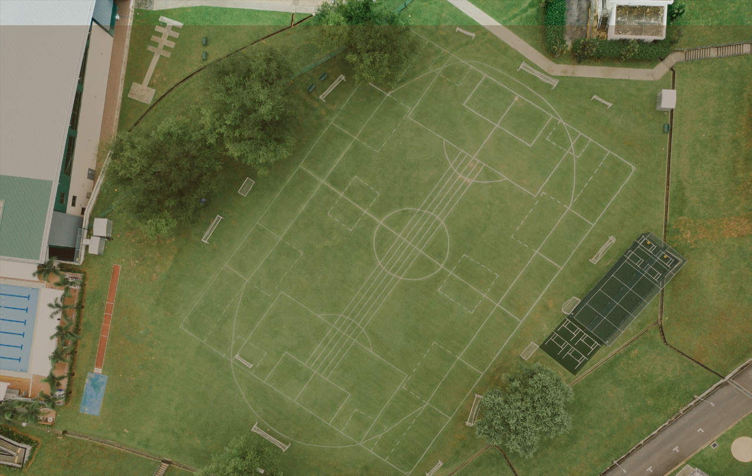
843.338.4097
www.diligencedone.net

